Slide 1

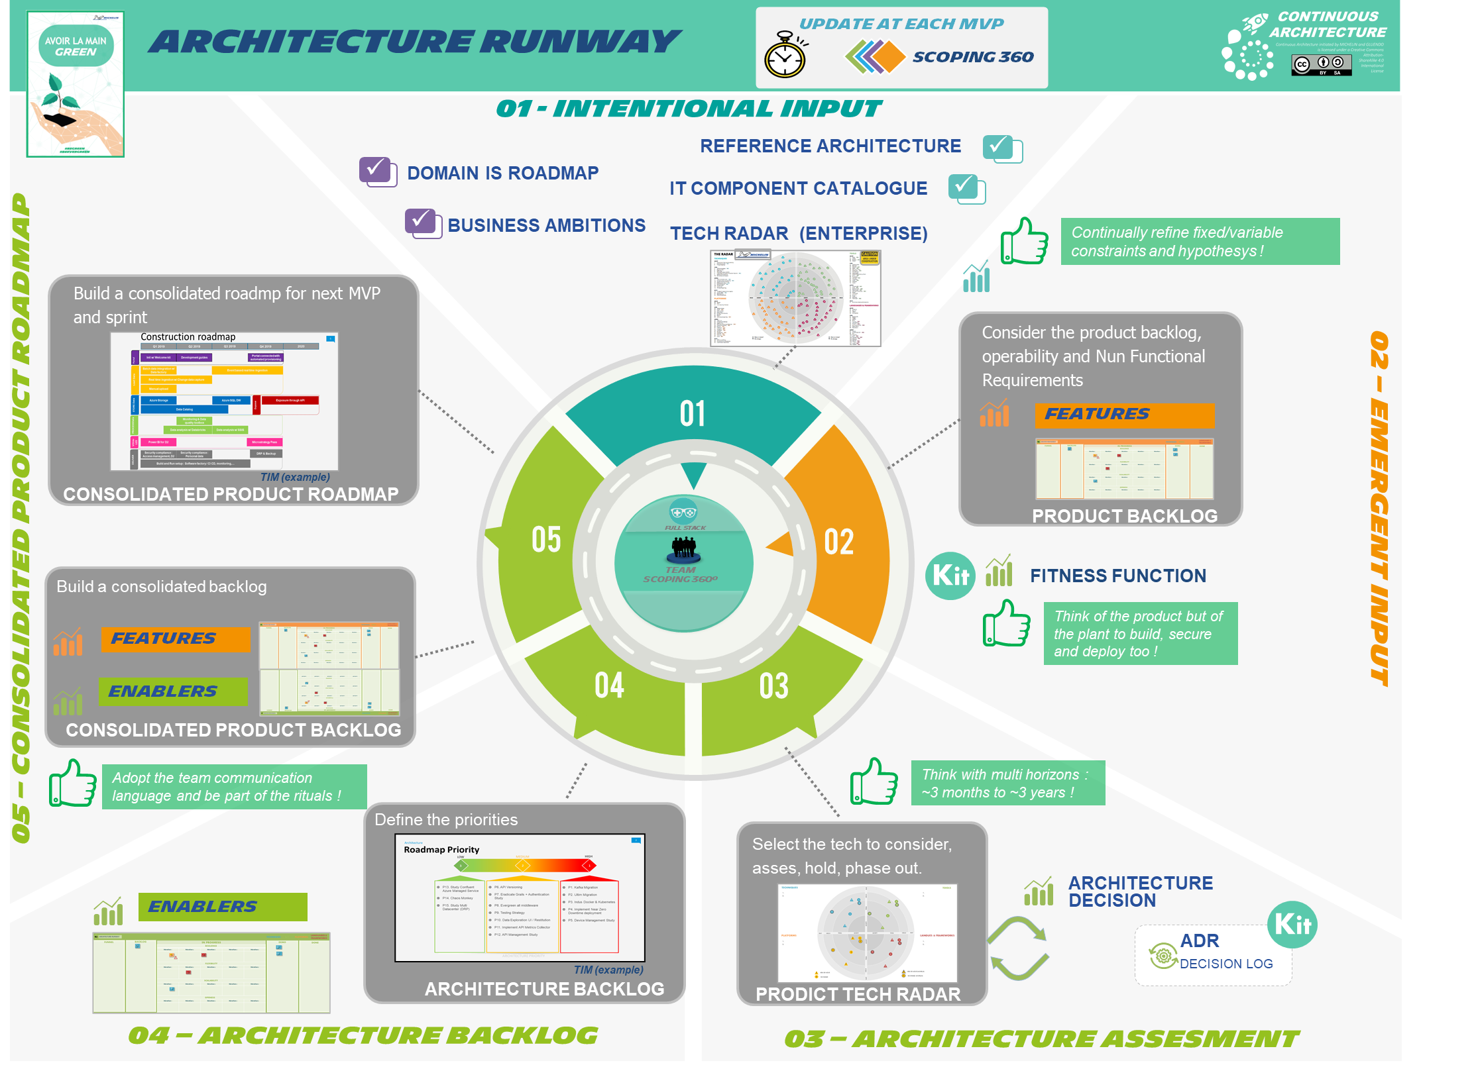


GLOBAL
OBSOLESCENCE
DECOM.
ROADMAP
LOCAL
TECHNICAL
DEBT
Notes:
Importance to consider in a consolidated way features and enablers
Consolidated backlog
Consolidated roadmap Just enough

